Slide 1
NDN-IoT Framework and Example Application “Flow”
Zhehao Wang
Jan 29, 2017
Notes:
Flow with a different name

Slide 2
Introduction
IP-IoT challenges
Complex solutions to simple communication needs
Limitations of channel- and session-based security
Poor integration of local communication
In this demo, we present
NDN-IoT, an IoT framework over NDN
“Flow”, a home entertainment application built using NDN-IoT

Slide 3
Introduction – NDN-IoT & Flow

Slide 4
NDN-IoT Framework

Slide 5
NDN-IoT: functionalities
NDN-IoT (Named Data Networking of Things) is a set of libraries implementing functionalities in the NDN team’s IoTDI 2016 paper [1]
Naming things, devices, and their data (VI.A, VI.H)
Schematized trust (VI.C)
Device and application bootstrap (VI.B, VI.C)
Device/service/capability discovery (VI.B)
Application-level pub/sub (VI.F)
[1] W. Shang, A. Bannis, T. Liang, Z. Wang, Y. Yu, A. Afanasyev, J. Thompson, J. Burke, B. Zhang, L. Zhang. Named Data Networking of Things (Invited Paper). In IoTDI, 2016
Notes:
We assume that the audience of this presentation (and Github readmes) is reasonably familiar with
- our IoTDI ‘16 invited paper
- common patterns (discovery / pubsub) in application development
- schematized trust
JB: could we argue that this framework implements or at least makes possible VI.H:
Yes, the discussion on name prefix should support this argument (added VI.H to the naming section), and a separate slide discussing that

Slide 6
NDN-IoT: naming
The framework can support arbitrary names. In our application we used three levels of names
Application/thing level: name the thing
An application-specific “label” given by the user
For application data exchange
Device level: name the device in a space
Some physical properties of the device to identify the device
For device control and status feedback
Manufacturer level: name given by the manufacturer
For initial device profile retrieval and verification
Notes:
Rev: removed “suggests” as ambiguous, and added naming convention reasoning in following slide
Separate note: ideally manufacturer namespace would be used for device bootstrapping as well, but that’s not the case in our practice

Slide 7
NDN-IoT: naming – cont
An example of the three levels of names
The framework suggests this naming convention to
Decouple data from the device publishing it
Reflect the trust relationship in a home IoT environment
Notes:
The example refers to the Unity3D game application running on an OSX box manufactured by apple.
Example uses a locally identifiable prefix.
Decouple data from the device publishing it: enable interoperability at the network and application layers.
Quote from IoTDI ‘16:
“NDN uses application-meaningful names at the network layer, which makes proper naming design a high priority when creating an NDN application. Although NDN applications are free to choose any naming model, following common naming conventions and trust relationships, and data payload formats can enable interoperability at the network and application layers”

Slide 8
Flow application: namespace
Notes:
JB: add device pictures?
Refer to later Flow installation diagram slide?

Slide 9
NDN-IoT: global Internet integration
Global Internet integration can be achieved using
A globally reachable prefix such as “/ucla/MelnitzHall/1469C”, or
A local prefix such as “/home”, with the help of forwarding hints* or encapsulation**
* Forwarding hints in NDN FAQ
** Map-and-encap discussed in NDN-TR004 rev2
Notes:
Added: move the “prefix” discussion here and talk about global Internet integration in this context

Slide 10
NDN-IoT: trust
NDN-IoT uses schematized trust [3], which
Leverages the structure of names to schematize decision-making on a packet-by-packet basis
Uses a schema file to define expected relationship between a data name and a KeyLocator key name, and forms a hierarchical structure
The framework uses a hierarchical trust model
A gateway serves as the trust anchor
The gateway’s key signs device certificates (device namespace) (RSA)
Each device’s key signs application data it produces (application namespace) (RSA, HMAC (constrained devices))
[3] Y. Yu, A. Afanasyev, D. Clark, K. Claffy, V. Jacobson, and L. Zhang. Schematizing Trust in Named Data Networking. In ICN’15, 2015
Notes:
JB: any framework/iot-specific trust assumptions on top of schematized trust ideas?
Trust model assumption: the existence of a trust anchor (which could delegate to others forming a chain, but not directly implemented in framework),
Bootstrap assumption: mutual knowledge of a shared secret, name of the device to be added. (both are manually put in to the gateway / controller)
JB: Is this general, in the sense that “sign” may mean HMAC? What algorithms are implemented?
Added parenthesis for
Framework supports ECC as well since underlying ndn-ccl supports it.

Slide 11
Flow application: trust relationship
Example trust relationship
Notes:
JB: “Gateway” idea seems a little new – maybe reason to introduce the term in reference to VI.H above?
Not sure how this relates to VI.H “global Internet integration”, other than that /[prefix]/gateway is the default convention for gateway device name
I was hoping this gateway was introduced in last slide bullet 2 sub-bullet 1.

Slide 12
NDN-IoT: bootstrap
Add device to home network
This step establishes trust relationship between gateway and the added device
Follows the process introduced in NDN-pi [4]: bootstrap trust between the gateway and a device using a shared secret established offline
Setting the device up as a producer / consumer
This step establishes trust relationship between device identity and application data it produces
To work as a producer, the device sends a command interest to the gateway asking for permission to publish under an application prefix
To work as a consumer, the device sends interests for the trust schema of an application
[4] A. Bannis, J. Burke. Creating A Secure, Integrated Home Network of Things with Named Data Networking, Tech. Rep. NDN-0035, NDN, 2015
Notes:
JB: How is “home network” bootstrapped? Or at least what are assumed initial conditions?
Trust model assumption: the existence of a trust anchor (which could delegate to others forming a chain, but not directly implemented in framework),
Bootstrap assumption: mutual knowledge of a shared secret, name of the device to be added. (both are manually put in to the gateway / controller)
JB: offer simple definition of “bootstrap”?
Adding a new device to the network, using it for some applications and making sure it’s publishing data that is verifiable, or verifying data published by other devices correctly
Two-step bootstrap: adding device to the home network (arrow 1 in last slide’s pic), and authorizing the device as a consumer / producer in an application (arrow 2 in last slide’s pic)

Slide 13
NDN-IoT: bootstrap sequence
Notes:
Figure top: bootstrap step 1 - add device
Figure bottom: bootstrap step 2 – consumer / producer authorization

Slide 14
NDN-IoT: discovery
The framework implements distributed discovery (similar to ChronoSync [2]) of devices in a multicast namespace:
/home/devices/discovery/<digest>
Digest is a hash of names of devices known by the producer; Data content is the list of names
Each participant adds its own device name to this list and reply to interests for old digests
Upon receiving data, the participant issues device interest to know what application data the device publishes
[2] Z. Zhu and A. Afanasyev. Let's ChronoSync: Decentralized dataset state synchronization in NDN. In ICNP, 2013.

Slide 15
NDN-IoT: discovery sequence

Slide 16
NDN-IoT: app-level pub/sub
Pub/sub is a common communication paradigm in IoT applications
The framework implements pull-based pub/sub under two types of namespace abstractions
Timestamp-based namespace: uses exclusion filter to repeatedly ask for content
Sequence-number-based namespace: pipelines interests for the next few sequence numbers
Notes:
JB: Are these persistent subscriptions?
Up to application. First define persistency? Under my assumed definition, persistency would require additional mechanism in apps built on top of the framework.
JB: Reliable?
Technically, reliability in TCP’s sense, no: out of 3 elements of reliable delivery we have 2: uniquely identifiable data and retrx timers, but we technically don’t have positive ACK for each data

Slide 17
NDN-IoT: app-level pub/sub sequence
Interest-data exchanges for app-level pub/sub in timestamp and sequence-number namespaces:

Slide 18
NDN-IoT: constrained devices
The framework supports constrained devices by pairing them with more powerful “helpers”
Constrained devices may not run the forwarder, or do asymmetric signing, and instead delegates signing to the helper
We assume each constrained device has established a shared secret with a helper offline
Notes:
JB: What naming and trust relationships must constrained devices and helpers have?
Trust relationship assumption is given in slides: shared secret established offline
Naming relationship: actually not reflected. As of now it’s technically optional for constrained devices to use a named-data abstraction. The semantic between them is like: helper can trust constrained device no matter what the latter’s name is, as long as the key-exchange is signed by the expected HMAC key, and vice-versa

Slide 19
Flow: constrained device authorization
To make data published by constrained devices (e.g. an RFduino) verifiable, the device and its helper go through the following sequence

Slide 20
“Flow” Application
Notes:
Flow with a different name

Slide 21
Flow: introduction
Flow is a home IoT game application built on top of NDN-IoT framework. A player
Interacts with the game by walking around in an area tracked by OpenPTrack (opt)
Sees his physical tracks affect the terrain in a virtual space rendered by Unity3D game engine
Can also drop images to the virtual space using a mobile webpage
Can control the angles the virtual cameras are facing by rotating gyroscopes

Slide 22
Flow: components
Component | Device | Role
OpenPTrack (opt) | Linux workstation machine | Produces time-series data (location of multiple tracked persons) at 30Hz
Mobile website | Mobile phone | Sends environment control commands and consumes environment status
Virtual camera control | RFduino | Produces NDN data from gyroscope reading. Packetize, and send to helper (RaspberryPi) via bluetooth
Controller/Gateway | RaspberryPi2 | Serves as the trust anchor (runs NDN-pi controller)
Unity3D game engine | OSX machine | Consumes opt, phones, and Arduino data; and renders the virtual environment

Slide 23
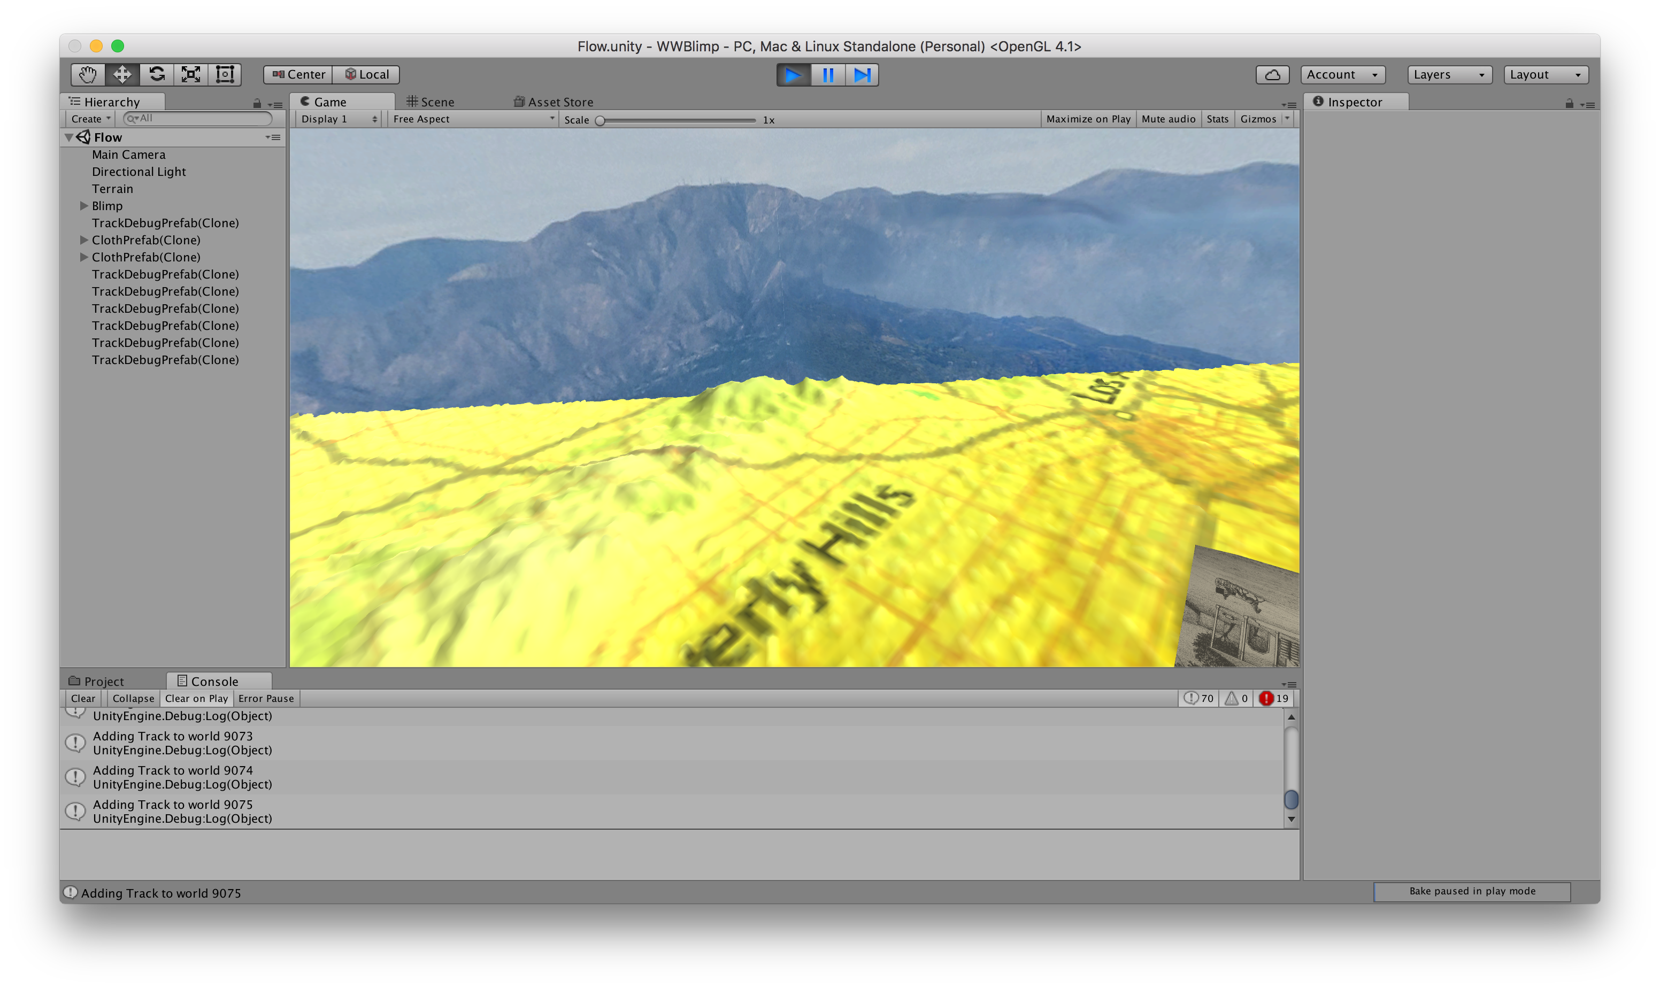
Flow: app message exchanges
Please refer to next page for diagram key
Notes:
JB: Better screenshot? From Zoe’s set?
This is from Zoe’s pic for the poster; meaning what exactly?

Slide 24
Flow: app message exchange keys

Slide 25
Links and documentation
Code repository
NDN-IoT framework
Functionality overview
Interface description
Flow application
Technical guide (installation and troubleshooting)
Demo poster

Slide 26
References
[1] W. Shang, A. Bannis, T. Liang, Z. Wang, Y. Yu, A. Afanasyev, J. Thompson, J. Burke, B. Zhang, L. Zhang. Named Data Networking of Things (Invited Paper). In IoTDI, 2016
[2] Z. Zhu and A. Afanasyev. Let's ChronoSync: Decentralized dataset state synchronization in NDN. In ICNP, 2013.
[3] Y. Yu, A. Afanasyev, D. Clark, K. Claffy, V. Jacobson, and L. Zhang. Schematizing Trust in Named Data Networking. In ICN’15, 2015
[4] A. Bannis, J. Burke. Creating A Secure, Integrated Home Network of Things with Named Data Networking, Tech. Rep. NDN-0035, NDN, 2015

Slide 27
Thanks
Notes:
Continue fleshing this out
Consider moving into tech report / documentation if that fits better

Slide 28
Appendix A: uncovered functionalities in IoTDI ‘16 paper
Section VI.D (access control)
Not implemented as its functionality is mostly covered in NDN-CCL
This functionality is available in PyNDN2, ndn-js, jndn, ndn-cpp, as well in ndn-group-encrypt
Section VI.E (aggregation)
Not implemented as not immediately useful for our current application
This is implemented in mini-BMS, NDN Building Management System emulation in mini-ndn
Notes:
Comment on why VI.D (access control) and VI.E (aggregation) are not implemented – and where to look for examples of this work.

Slide 29
Appendix B: scenarios in Flow installation and usage

Slide 30
Scenario 1: adding gateways and new devices to home
User has several gateways (e.g. routers) in his home; each one may cover several rooms
When installing the trust anchor gateway at home for the first time, user will be asked to provide its name
For example, router serial-1234 should generate a key pair for identity “/home/devices/gateway/”, and a self-signed certificate)
The user could then add devices trusted by the trust anchor gateway (or by other gateways who are already added using the process “bootstrap – add device”. In this case, multiple gateways form a chain of trust.)
Notes:
This identity “/alice-home/router1” is still considered to be in device namespace

Slide 31
Scenario 2: buying Flow and installing at home
After acquiring the necessary hardware and setting them up at home, the user buys Flow software, verifies the binaries with developer’s certificate, and installs on various devices
Before launching, user configures Flow application prefixes on each piece of hardware, and upon first launch the application binary requests producing authorization.
Installation is complete after user authorizes application publishing requests.
Notes:
Huawei is providing the ISP-level service that enables these networks to be linked

Slide 32
Scenario 3: replacing a device using the same application level name
Imagine that an old “gyro1” breaks, we replace it with a new one also called “gyro1”
To achieve this, the user follows the application prefix configuration step described in previous slide
Name the new gyroscope “gyro1”
Run “bootstrap – producer authorization” on the new gyroscope to tell the gateway to update trust schema with new device certificate for data under “gyro1” prefix

Slide 33
Appendix C: issues reflection
Library interface
Interface design needs improvement (e.g. not straight forward return values and parameters in bootstrap and discovery; not conformed OnValidationFailed interface)
Library mechanism
Library lacks conformed error reporting and exception handling
Build system and scripts need minor revisions (e.g. currently some framework libraries may require further steps between waf configure and waf)
Unused functionality
Demo does not cover discovery
Demo does not show security: verified data vs unverified data
Library documentation
Unevaluated documentation: no one actually followed the documentation to develop an application
Library usability
Library lacks example code
Library lacks test suites for coverage and robustness testing

Slide 34
Appendix D: manufacturer and code/binary trust schema
Trust schema in manufacturer namespace
Trust schema in application binary data namespace
Notes:
Appendix: not incorporated yet.

